Slide 1
Keeping Moms and Infants Healthy Team Members: Arelys Alvarez Andy Herrera Product Owner: Jean Hannan Professor: Masoud Sadjadi School of Computing and Information Sciences Florida International University
Senior Project Final Presentation Fall 2019
12/06/2019
Notes:
Greet your audience, thank them for attending your presentation, introduce yourself, introduce your project, introduce your team members, and quickly indicate what each of you did in a high-level manner, and put more emphasis on your part/contribution.

Slide 2
Problem definition
Smartphone-based maternal/infant healthcare application
Supports 3 languages: English, Spanish & Creole
Designed for low-income minority mothers
Provides early and continued access to prenatal and postnatal health care
Notes:
Introduce the problem that the whole project tackles and stay focused on the parts that you have been working. Indicate if there is an existing previous system, enumerate its problems/limitations, etc.

Slide 3
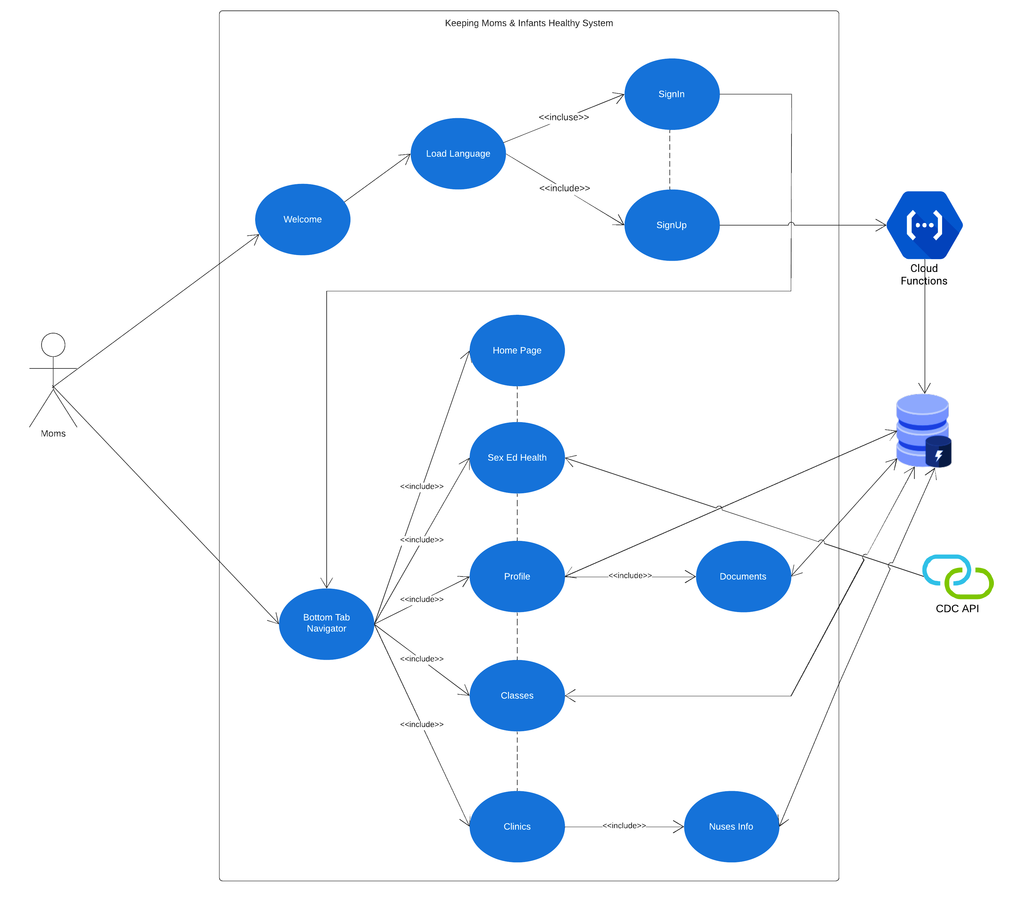
Use Case
Notes:
4. Requirements:
4.1. User stories implemented (one or more slides).
4.2. UML use cases and the use case diagram for the implemented use cases (one or more slides).
4.3. UML sequence diagrams for the implemented use cases.

Slide 4
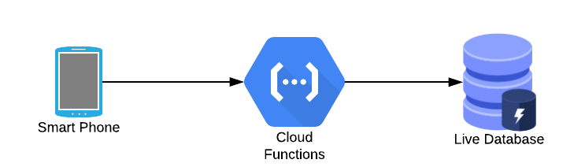
Architecture
Notes:
5. System design:
5.1. System decomposition; identify the architecture patterns used (one slide).
5.2. System deployment – h/w and s/w requirements (one slide).
5.3. Persistent data design (one slide).
5.4. Security/Privacy (one slide).

Slide 5
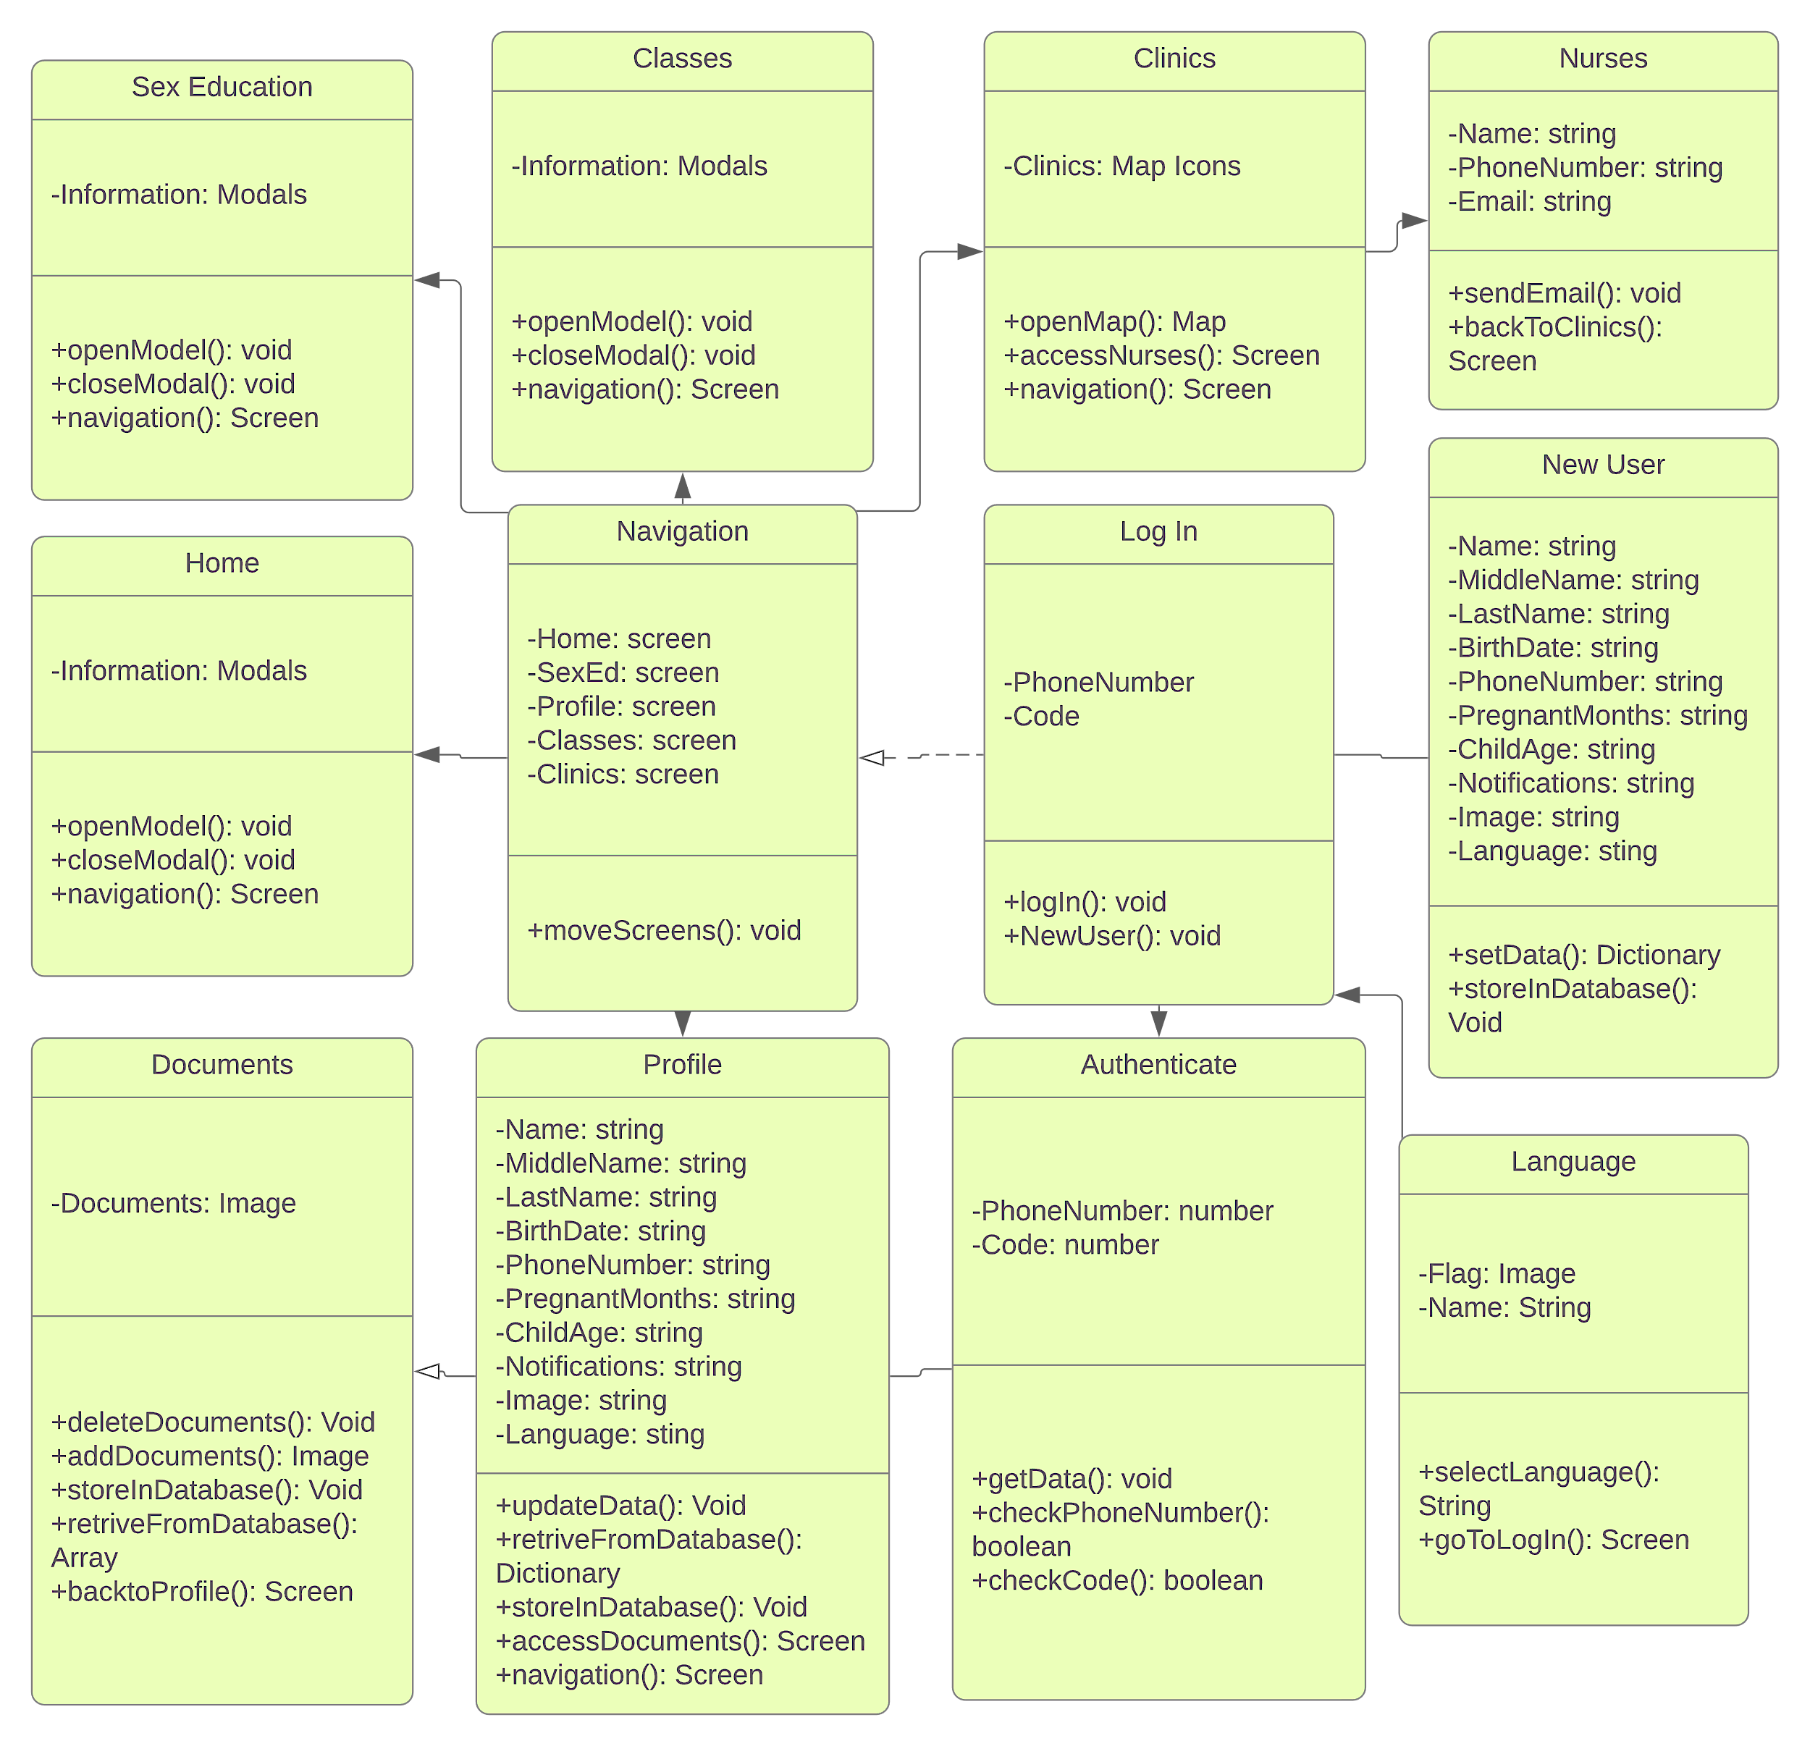
Class Diagram
Notes:
6. Detailed design:
6.1. Minimal class diagram. Identify the design patterns used (one or more slides).
6.2. State machine for the main control object or the most important object of the implemented uses cases (one or more slides).
6.3. Main algorithm used related to an implemented use case described above (one or more slides).

Slide 6
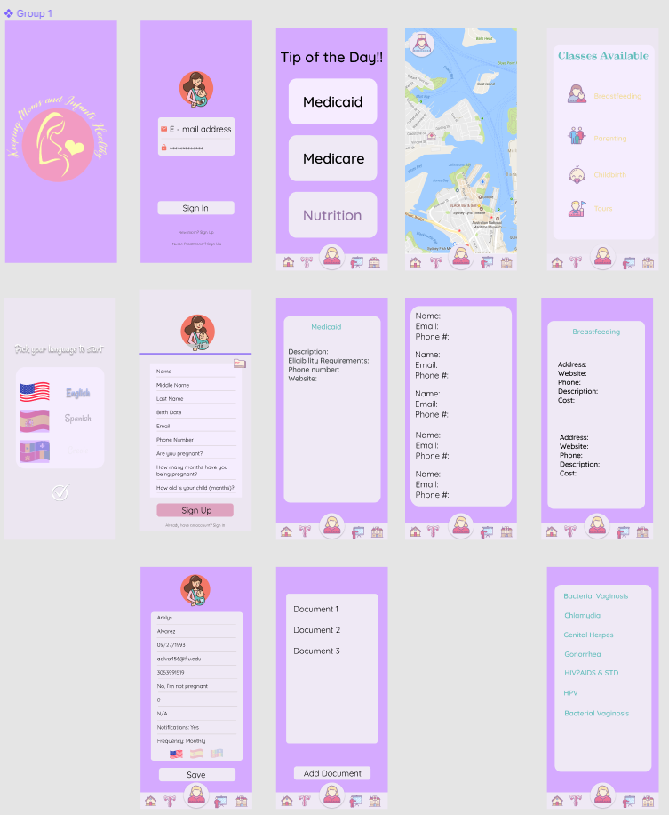
System Design
Notes:
5. System design:
5.1. System decomposition; identify the architecture patterns used (one slide).
5.2. System deployment – h/w and s/w requirements (one slide).
5.3. Persistent data design (one slide).
5.4. Security/Privacy (one slide).

Slide 7
Summary
The Keeping Moms & Infants Healthy (KMIH) Version 1.0 now allows low income moms to create an account in the application and research information related to their pregnancy and/or babies all in one single place.
Questions?
Thank You!
Notes:
Summarize your contribution
Include your contact information
Ask if anyone has any questions for you.
Thank your audience

